Slide 1
Electricity
( continues)
Types of lights
1. Incandescent lights.
2. Energy saving lights.
3.Light emitting diodes (LED)

Slide 2
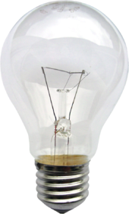
1.Incandescent lights
- It is used for stripping and cutting of wires.
Advantages
1. It is inexpensive (cheap).
2. Its easy to install.
3. Its easier to dim.
Disadvantages
1.It uses more electricity.
2. Life span is short.
3. It is energy insufficient.
- It is used for cutting and stripping of wires.

Slide 3
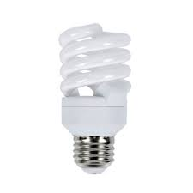
2.Energy saving lights
- It is a source of artificial that employs advance technology to reduce amount of energy used.
Advantages
1. Energy savings.
2. Longer lifespan.
Disadvantages
1.High initial cost.
2. Not easy to dim.
- It is used for cutting and stripping of wires.

Slide 4
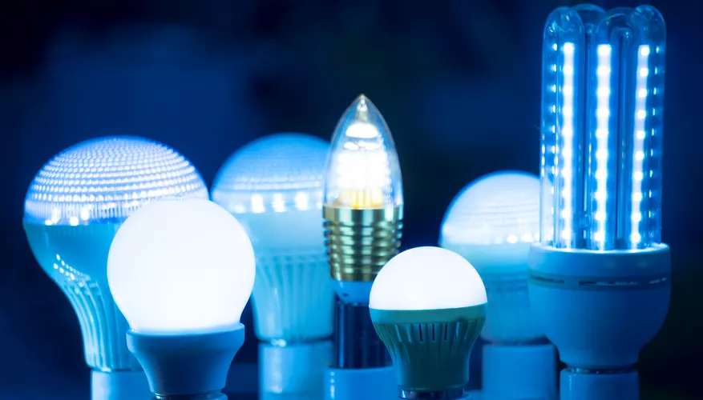
3.Light Emitting Diode(L.E.D)
- It is a semi conductor-conductor light source that emits light when the current flows through.
Advantages
1. Available in different colours.
2. Longer lifespan.
Disadvantages
1. They are expensive.
2. Can get damaged due to high voltage sometimes.
- It is used for cutting and stripping of wires.

Slide 5
Feedback
Activity : Worksheet 1
Kwa Thema Skills School
Subject : Maintenance Marks: 15
Grade : Year 2 Time : 30mins
Date :
Question : 1
1.Name any five building and plastering materials.
1.1 ________________________
1.2 ________________________
1.3 ________________________
1.4 ________________________
1.5 ________________________
(5)

Slide 6

Question:2
1.Identify the following building and plastering materials.
1.____________________ 2.______________________
3.___________________ 4. ______________________
5. ______________________ 6. ______________________

Slide 7
Question:2
1.____________________ 2.______________________
3.___________________ 4. ______________________
5. ______________________ 6. ______________________

